Slide 1
US Decision Science
Estimating Lagged Effect of Promotional Interventions
Jan 2007

Slide 2
Objective
Review approaches used in PM&T group for estimating lagged effect of promotional interventions

Slide 3
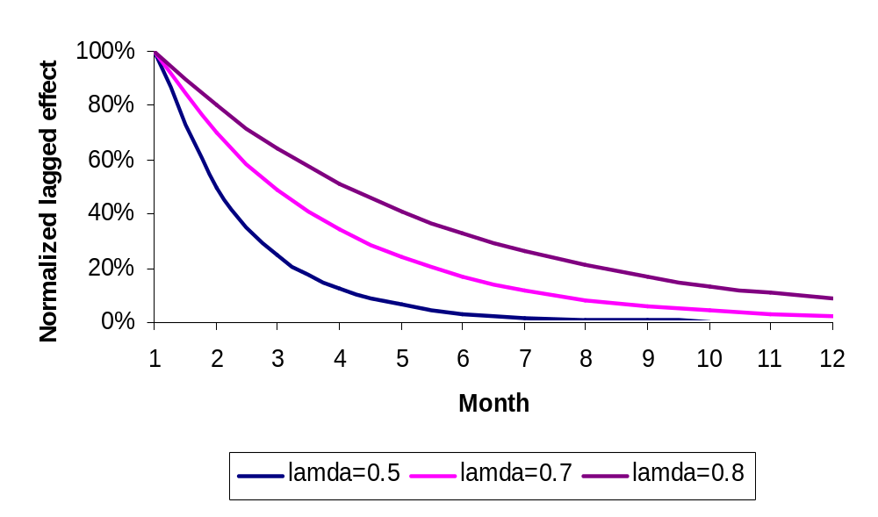
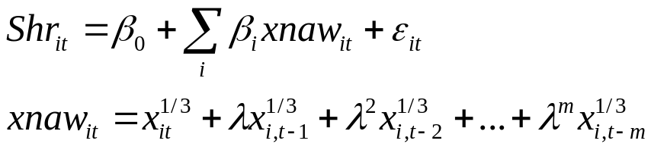
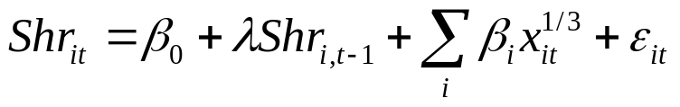
Conventional Lag Structure (Geometric Decay)
Estimation methods-NAW, Koyck
Assumes that the lagged effect is same for all channels
Assumes a geometric decay
Cannot handle the case of peak effect of promotion occurring in a period after the promotional period
NAW Method:
Involves constructing NAW (stock) variables
Involves grid search for the estimate of lamda
Assumes no effect after a specific period (m in this example)
Koyck Method:
Automatic estimation of lamda

Slide 4
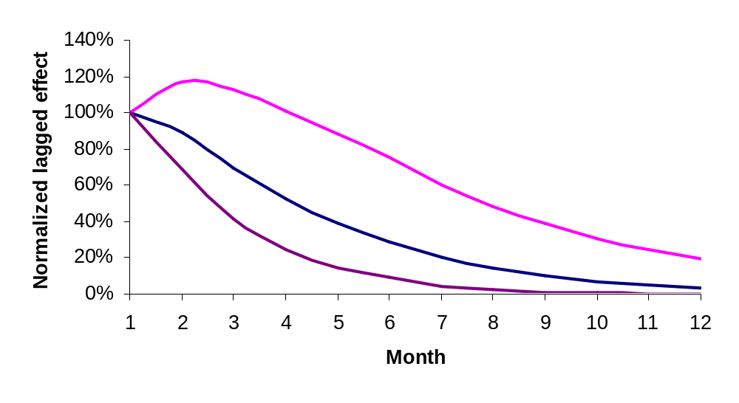

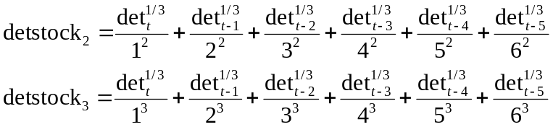
PIL (Polynomial Inverse Distributed Lag Structure)
Estimation methods-PIL
Can accommodate different lags for different channels
Does not assume a geometric decay
Can handle the case of peak effect of promotion occurring in a period after the promotional period
Regression model with lagged predictors
(Only details shown for illustration)
Lagged effects constrained to lie on a polynomial
Translates to working with two stock variables for details and estimating a regression on two parameters (α1 and α2)

Slide 5
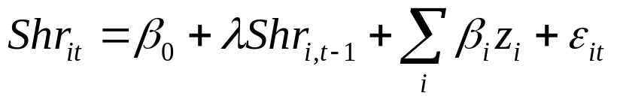



Estimation Method
Model is estimated in stages to address multicollinearity
Stage 0:
  Construct orthogonal auxiliary variables {z1, z2,…,zk} that approximate the original variables {x1,x2,…,xk}
    Find the (latent) Z variables such that correlation with (manifest) X variables is maximized (SVD Method)
Stage 1:
  Perform a regression using Z-variables
Stage 2:
  Assume the relative impact of X variables to be the same as Z variables
  Create a new variable
  Perform a regression on the new variable
The coefficient for variable x_i is

Slide 6
Comparison of decay from Koyck and PIL models – Cialis Example

Slide 7
Comparison of decay from Koyck and PIL models – Evista Example

Slide 8
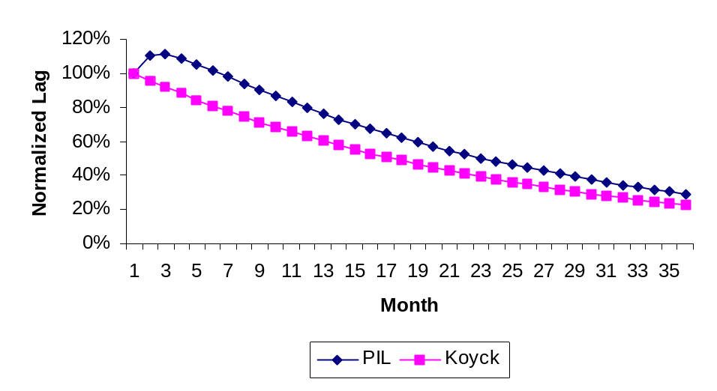

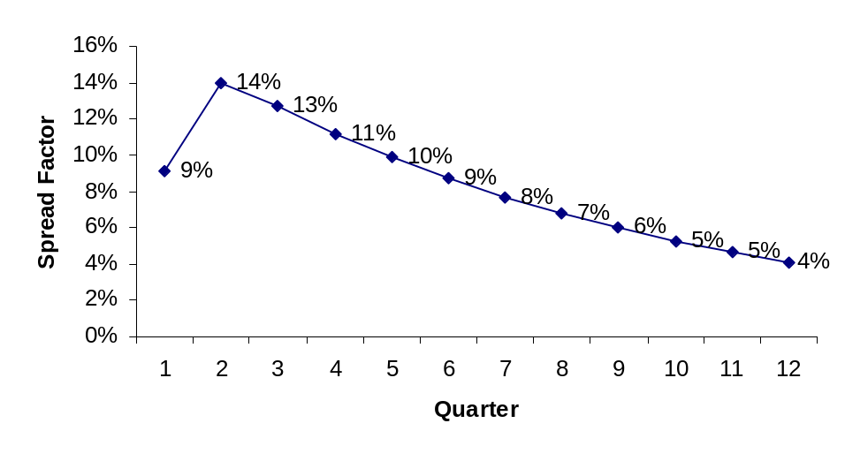
Comparison of decay from Koyck and PIL models – Cymbalta MDD 7-10
λ=0.959
3 Yr Inc Revenue ($MM)
λ=0.959
Spread factor (based on PIL model) to SET
CO = 108%

Slide 9
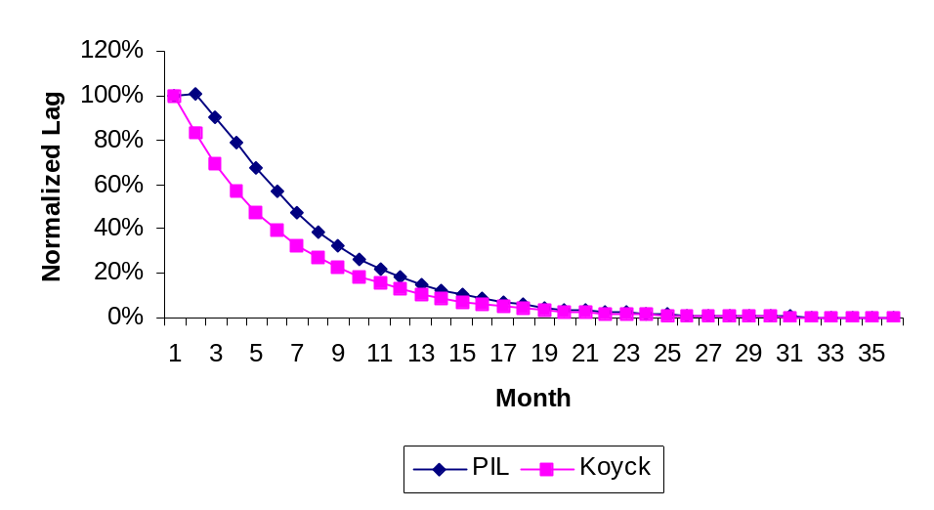

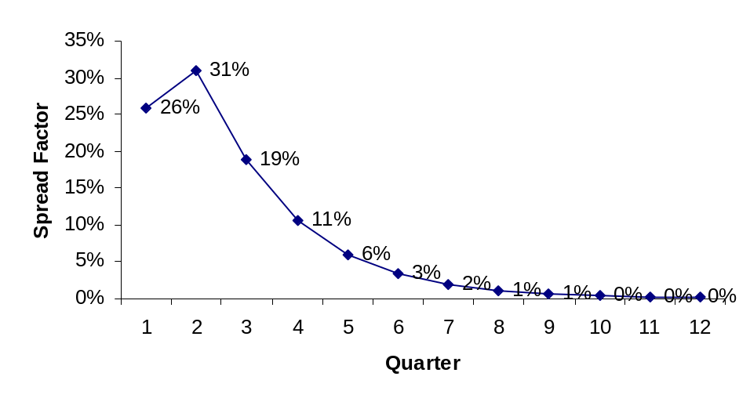
Comparison of decay from Koyck and PIL models – Cymbalta DPNP Neu/Pain 7-10
3 Yr Inc Revenue ($MM)
λ=0.826
λ=0.83
Spread factor (based on PIL model) to SET
Implied yearly CO = 44%

Slide 10
Other considerations
Using same decay across the segments vs Using different decay patterns by segment
Monthly versus quarterly model
NRx versus share model

Slide 11
Recommended method

